Slide 1
Problem solving with expressions and formulae
Expressions and formulae

Slide 2
How our teaching resources are designed for the classroom

Slide 3
I can use my knowledge of expressions and formulae to solve problems.

Slide 4
A binomial is an algebraic expression representing the sum of exactly two unlike terms.
Examples
x + 2
5 − 6x
x²− x
a + 2y
A compound shape is a shape created using two or more basic shapes.

Slide 5

Problem solving with expressions and formulae
Forming expressions for area
Area of compound shapes

Slide 6
Forming expressions for area
We can use the product of two binomials to write expressions for the area of shapes where the side lengths are given as binomial expressions.
x + 7
How could we write an expression for the area of this shape?
x − 1
area = width × length
= (x + 7)(x − 1)
We could find an equivalent expression by expanding.
(x + 7)(x − 1) ≡ x² − x + 7x − 7
≡ x² + 6x − 7

Slide 7
Forming expressions for area
How could we write an expression for the area of this shape?
This is a square so the area can be written as (3x + 2)²
3x + 2
≡ (3x + 2)(3x + 2)
≡ 9x² + 6x + 6x + 4
≡ 9x² + 12x + 4
All of these are expressions for the area of this shape just in different forms.

Slide 8
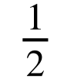
Forming expressions for area
We can do the same for any shape as long as we have an expression for all the dimensions needed for working out the area.
The area of a triangle can be calculated by multiplying the base by the perpendicular height and then dividing by 2.
Using the formula:
area = × base × height
2x + 2
(x + 5)(2x + 2)
How else could we write this?
x + 5

Slide 9
Forming expressions for area
(x + 5)(2x + 2)
How else could we write this?
We can multiply the binomials then find half of that product.
≡ (2x² + 2x + 10x + 10)
≡ (2x² + 12x + 10)
2x + 2
To half the whole expression, we can multiply each term by
x + 5
≡ x² + 6x + 5

Slide 10
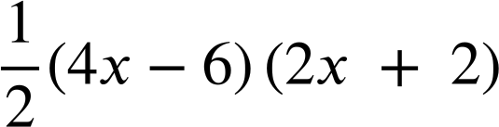
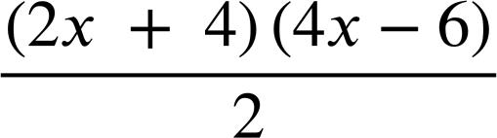
Forming expressions for area
Which of these could be expressions for the area of this triangle?
(x + 2)(2x − 3)
(2x + 4)(2x − 6)
4x − 6
(x + 2)(4x − 6)
(2x + 4)(4x − 6)
This value should be 4
2x + 4
(x + 4)(2x − 6)
(2x + 4)(2x − 3)

Slide 11
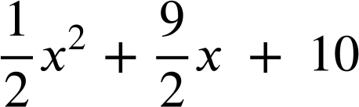
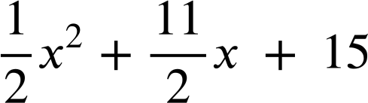
Forming expressions for area
Here is a trapezium.
To work out a simplified expression for the area we could split it into two triangles.
Area of A: (x + 4)(x + 5)
x + 4
(x² + 9x + 20)
A
x + 5
B
Area of B: (x + 6)(x + 5)
(x² + 11x + 30)
x + 6

Slide 12
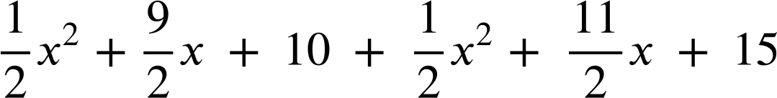

Forming expressions for area
x + 4
Area of A: (x + 4)(x + 5)
(x² + 9x + 20)
A
x + 5
B
Area of B: (x + 6)(x + 5)
(x² + 11x + 30)
x + 6
Total:

Slide 13
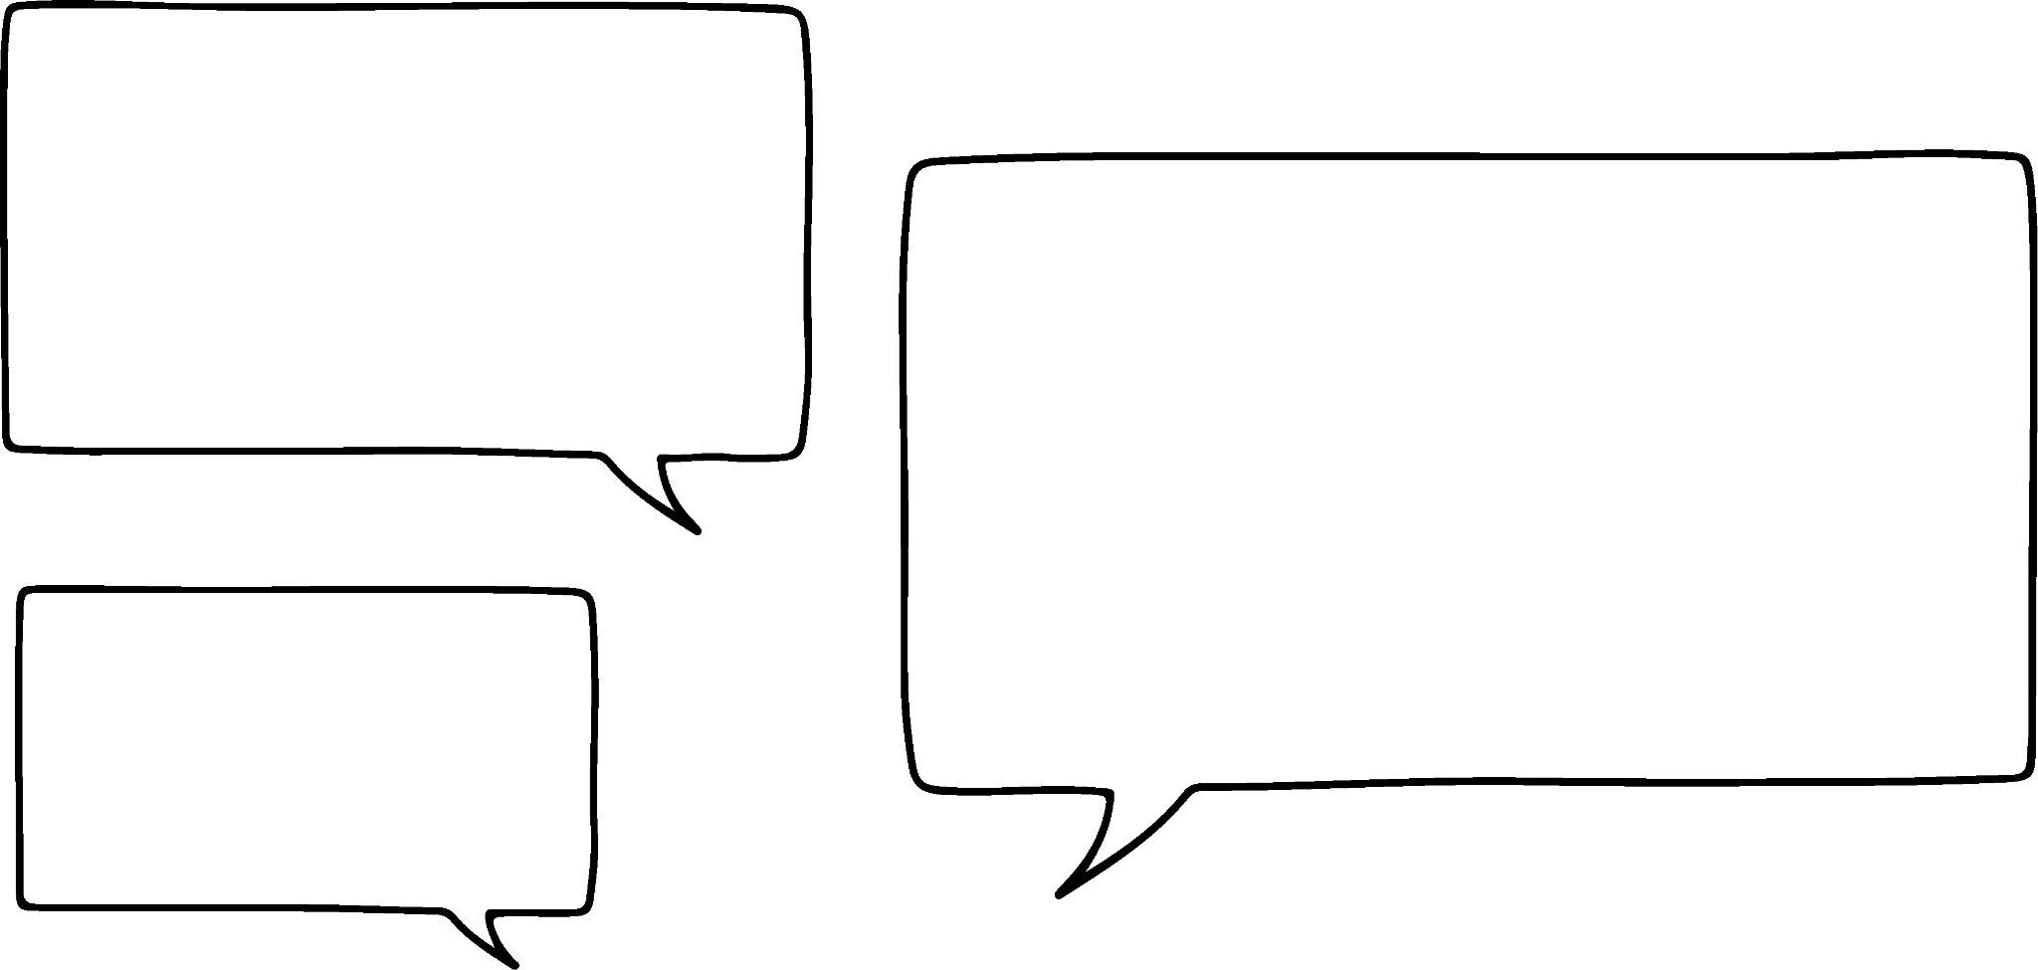

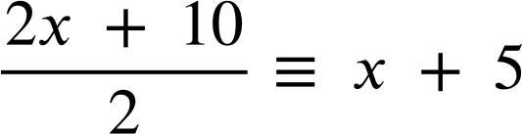
Forming expressions for area
x + 4
I think I know an easier way to find the area of a trapezium
x + 5
Aisha
x + 5
We can start by adding the parallel sides together and dividing by 2
This finds the middle of the two lengths.
x + 6
x + 4 + x + 6 ≡ 2x + 10

Slide 14
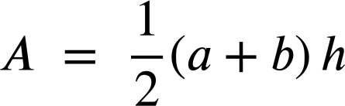
Forming expressions for area
I think I know an easier way to find the area of a trapezium
x + 5
Aisha
x + 5
Then we can multiply that by the height.
≡ (x + 5)(x + 5)
≡ x² + 10x + 25
Aisha has used the formula for the area of a trapezium:
Where a and b are the parallel sides.

Slide 15

Forming expressions for area
Laura wants a simplified expression for the area of this trapezium.
She uses the formula (where a and b are the parallel sides.)
x + 5
Where has she made a mistake?
x + 3
(x + 5 + x + 3)(3x + 7)
(2x + 8)(3x + 7)
3x + 7
Laura
She has used the wrong dimensions. She should have added the parallel sides and multiplied by the perpendicular height.
(x + 4)(3x + 7)
3x² + 7x + 12x + 28
3x² + 19x + 28

Slide 16
Forming expressions for area
Laura wants a simplified expression for the area of this trapezium.
She uses the formula
x + 5
I’ll try again.
2x + 6
x + 3
(x + 5 + 3x + 7)(x + 3)
3x + 7
Laura
(4x + 12)(x + 3)
That’s what I got too.
Aisha
(2x + 6)(x + 3)
2x² + 6x + 6x + 18
2x² + 12x + 18

Slide 17
Forming expressions for area
Here are some formula for the area of 2D shapes which may help you with the following task.
a
l
b
h
w
h
b
area = width × length
area = × base × height
area = × × height
Where a and b are the parallel sides.

Slide 18
Forming expressions for area
1) Write a sentence explaining why the area of this shape can be written in each of the following ways:
a) (x − 4)²
b) (x − 4)(x − 4)
c) x² − 8x + 16
2) Draw a rectangle with an area of (6 + y)(2 + y) write a different expression for the area of your rectangle.
x − 4

Slide 19
Forming expressions for area
3a) Explain why the area of this shape can be written as
(4x + 5)(6x + 2)
6x + 2
b) Write the expression for the area of this shape in two different ways.
4x + 5
c) Draw and label a triangle with area (x + 1)(3x − 2)

Slide 20
Forming expressions for area
4) Match these shapes to the correct expression for their area.
a
b
2x + 2
c
d
x + 2
x + 1
x + 2
x + 1
4x − 4
4x − 4
4x − 4
2x − 2
e
f
g
h
x² − 1
2x²+ 2x − 4
3x²+ 2x − 1
4x²+ 4x − 8

Slide 21
Forming expressions for area
1) Write a sentence explaining why the area of this shape can be written in each of the following ways:
a) (x − 4)²
b) (x − 4)(x − 4)
c) x² − 8x + 16
The shape is a square so the area can be found by squaring one side length.
x − 4
Squaring an expression is the same as multiplying that expression by itself. (x − 4)² ≡ (x − 4)(x − 4)
We can multiply the binomials using the distributive law: (x − 4)(x − 4) ≡ x(x − 4) − 4(x − 4) ≡ x² − 4x − 4x + 16 ≡ x² − 8x + 16

Slide 22
Forming expressions for area
2) Draw a rectangle with an area of (6 + y)(2 + y) write a different expression for the area of your rectangle.
6 + y
(y + 6)(y + 2) or equivalent binomials.
2 + y
y² + 2y + 6y + 12
y² + 8y + 12

Slide 23
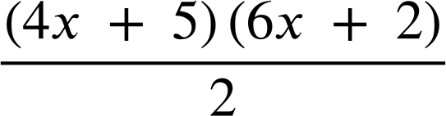
Forming expressions for area
3a) Explain why the area of this shape be written as
(4x + 5)(6x + 2)
The area of a triangle can be calculated by multiplying the base by the height and multiplying by a half.
6x + 2
b) Write the expression for the area of this shape in two different ways.
4x + 5
E.g.
(4x + 5)(3x + 1)
(2x + 2.5)(6x + 2)
12x² + 4x + 15x + 5
12x² + 19x + 5

Slide 24
Forming expressions for area
c) Draw and label a triangle with area (x + 1)(3x − 2)
6x − 4
or
2x + 2
x + 1
3x − 2
The binomials can be on either dimension.

Slide 25
Forming expressions for area
4) Match these shapes to the correct expression for their area.
a
b
2x + 2
c
d
x + 2
x + 1
x + 2
x + 1
4x − 4
4x − 4
4x − 4
2x − 2
(4x − 4)(x + 2)
(6x − 2)(x + 1)
(4x − 4)(x + 2)
(2x − 2)(x + 1)
(2x − 2)(x + 2)
(3x − 1)(x + 1)
4x²+ 8x − 4x − 8
(x − 1)(x + 1)
2x²+ 4x − 2x − 4
3x²+ 3x − x − 1
x²+ x − x − 1
e
f
g
h
x² − 1
2x²+ 2x − 4
3x²+ 2x − 1
4x²+ 4x − 8

Slide 26
Problem solving with expressions and formulae
Forming expressions for area
Area of compound shapes

Slide 27
Area of compound shapes
Areas of compound shapes can be found by splitting them into shapes whose area can be found.
x + 2
x + 2
We need to find the missing length of the smaller rectangle first.
3x + 5
2x + 1
2x + 1
2x + 3
2x + 3

Slide 28
Area of compound shapes
Areas of compound shapes can be found by splitting them into shapes whose area can be found.
x + 2
x + 2
3x + 5 − (2x + 1)
?
x + 4
3x + 5 − 2x − 1
x + 4
3x + 5
2x + 1
Now we can work out expressions for both areas.
2x + 3

Slide 29

Area of compound shapes
x + 2
I know another way to do it!
Alex
2x + 1
x + 4
2x + 3
(x + 2) (x + 4)
x² + 4x + 2x + 8
x² + 6x + 8
(2x + 3) (2x + 1)
4x² + 2x + 6x + 3
4x² + 8x + 3
Total area:
x² + 6x + 8 + 4x² + 8x + 3
5x² + 14x + 11
The calculation we have done is:
(x + 2)(x + 4) + (2x + 3)(2x + 1) ≡ 5x² + 14x + 11

Slide 30
Area of compound shapes
We could also see this as one big rectangle subtract a smaller rectangle.
x + 2
Alex
3x + 5
2x + 1
2x + 3
What are the dimensions of these rectangles?

Slide 31
Area of compound shapes
x + 2
?
x + 4
3x + 5
?
3x + 5
x + 1
2x + 1
2x + 3 − (x + 2)
2x + 3 − x − 2
2x + 3
2x + 3
x + 1
3x + 5 − (2x + 1)
x + 4

Slide 32
Area of compound shapes
We can now expand simplify:
(3x + 5)(2x + 3) − (x + 1)(x + 4)
x + 4
3x + 5
6x² + 9x + 10x + 15 − (x² + x + 4x + 4)
x + 1
6x² + 19x + 15 − (x² + 5x + 4)
5x² + 14x + 11
2x + 3
Which method did you prefer?

Slide 33
Area of compound shapes
Work out the missing dimensions on this compound shape.
5x + 7
5x + 7 − (2x + 3)
3x + 2
3x + 4
3x + 4
6x + 1
3x + 2 + (3x − 1)
3x − 1
6x + 1
2x + 3

Slide 34
Area of compound shapes
How could we calculate the area of the shaded shape?
Subtract the area of the smaller rectangle from the larger rectangle.
(2x + 1)(x + 9) − (x + 2)(x − 1)
x − 1
2x² + 18x + x + 9 − (x² − 1x + 2x − 2)
x + 9
x + 2
2x² + 19x + 9 − (x² + x − 2)
x² + 18x + 11
2x + 1
9 − (−2) = 11

Slide 35


Area of compound shapes
The area of the shaded shape is 250 square units.
Which of these is an equation for the area of the shaded shape?
x + 1
x + 8
x + 5
a
(x + 10)(x + 1) − (x + 5)(x + 8) = 250
x + 10
b
(x + 10)(x + 8) + (x + 1)(x + 5) = 250
c
(x + 10)(x + 8) − (x + 5)(x + 1) = 250
d
(x + 10) − (x + 5) × (x + 8) − (x + 1) = 250

Slide 36
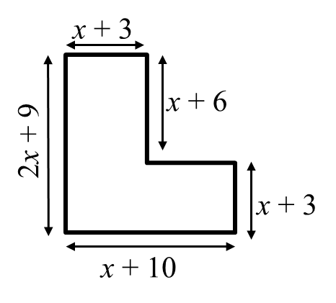
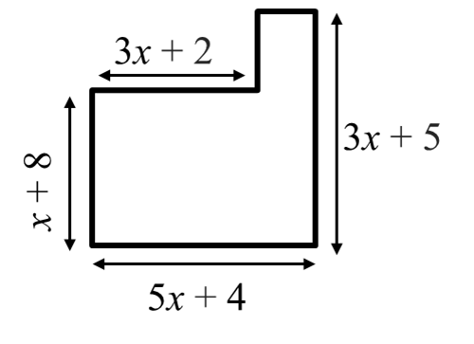
Area of compound shapes
1) Write a simplified expression for the area of this shape.
2) Write a simplified expression for the area of this shape.

Slide 37
Area of compound shapes
3a) Calculate a simplified expression for the area of the shaded shape.
x + 7
x − 2
x − 2
x + 12
b) The area of the shaded shape is 149 square units. Use this to find the value of x

Slide 38
Area of compound shapes
4a) Calculate a simplified expression for the area of the shaded shape.
Not drawn to scale
3x
2x + 7
4x − 1
6x − 9
b) The area of the shaded shape is 99 square units. Use this to find the value of x

Slide 39
Area of compound shapes
5) Four identical rectangles sit round the outside of a shaded square.
2x + 3
a) Find a simplified expression for the area of one rectangle.
b) Find a simplified expression for the area of the whole shape.
c) Find a simplified expression for the area of the shaded square.
x + 2

Slide 40
Area of compound shapes
1) Calculate a simplified expression for the area of this shape.
2) Calculate a simplified expression for the area of this shape.
5x + 4 − (3x + 2)
2x + 2
(3x + 2)(x + 8) + (2x + 2)(3x + 5)
(x + 10)(x + 3) + (x + 6)(x + 3)
(3x² + 24x + 2x + 16) + (6x² + 10x + 6x + 10)
(x² + 13x + 30) + (x² + 9x + 18)
(3x² + 26x + 16) + (6x² + 16x + 10)
2x² + 22x + 48
9x² + 42x + 26

Slide 41
Area of compound shapes
3a) Calculate a simplified expression for the area of the shaded shape.
(x + 12)(x + 7) − (x − 2)(x − 2)
(x² + 7x +12x + 84) − (x² − 2x − 2x + 4)
x + 7
x − 2
(x² + 19x + 84) − (x² − 4x + 4)
x − 2
23x + 80
x + 12
b) The area of the shaded shape is 149 square units. Use this to find the value of x
23x + 80 | = | 149
23x + 80 − 80 | = | 149 − 80
23x | = | 69
x | = | 3

Slide 42
Area of compound shapes
4a) Calculate a simplified expression for the area of the shaded shape.
(6x − 9)(2x + 7) − 3x(4x − 1)
(12x² + 42x − 18x − 63) − (12x² − 3x)
3x
(12x² + 24x − 63) − (12x² − 3x)
2x + 7
4x − 1
27x − 63
6x − 9
27x − 63 | = | 99
(27x − 63) ÷ 9 | = | 99 ÷ 9
3x − 7 | = | 11
3x − 7 + 7 | = | 11 + 7
3x | = | 18
x | = | 6
b) The area of the shaded shape is 99 square units. Use this to find the value of x

Slide 43
Area of compound shapes
5) Four identical rectangles sit round the outside of a shaded square.
2x + 3
a) Find a simplified expression for the area of one rectangle.
b) Find a simplified expression for the area of the whole shape.
c) Find a simplified expression for the area of the shaded square.
(2x + 3)(x + 2) ≡ 2x² + 4x + 3x + 6
≡ 2x² + 7x + 6
2x + 3 + x + 2 ≡ 3x + 5
x + 2
(3x + 5)² ≡ 9x² + 30x + 25
4(2x² + 7x + 6) ≡ 8x² + 28x + 24
2x + 3 − (x + 2) ≡ x + 1
or
9x² + 30x + 25 − (8x² + 28x + 24) ≡ x² + 2x + 1
(x + 1)² ≡ x² + 2x + 1

Slide 44
Problem solving with expressions and formulae
When lengths of a shape are given as expressions, the distributive law can be used to write an expression for the area in expanded form.
The area of compound shapes or shaded regions can be found by adding or subtracting the areas of known shapes.

Slide 45

© Oak National Academy 2024.
Produced in partnership with Mathematics in Education and Industry.
Licensed on the Open Government Licence v3.0, except where otherwise stated. See Oak terms and conditions.

